Slide 1
01
Value of Power Quality
Improve quality of power to increase productivity

Slide 2
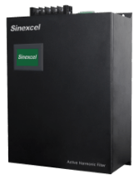
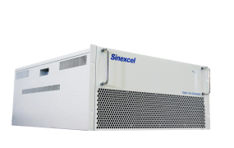
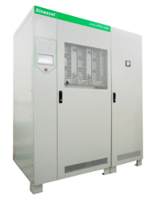
01
Sinexcel Power quality
Devoted to low voltage Power Quality business
Harmonic Compensation
IEEE519 standard
Operation reliability
Energy efficiency
Power Factor Correction
Penalty of electricity
Demand charge
Release system capacity
Remain voltage of grid
Voltage Sag Recovery
Production material lose Production capacity lose
Active Harmonic Filter
Static Var Generator
Active Voltage Conditioner

Slide 3
02
Inverter Based PQ-Harmonic mitigation
Active Harmonic Filter

Slide 4
02
Where does harmonic come from?
What are the impacts of harmonic?
Frequency
7N
5N
3N
N(50Hz/60Hz)
7th harmonic
5th harmonic
3rd harmonic
fundamental
1st harmonic
Transformer
Copper loss and iron loss, lifespan decreased
VFD, 6-pulse rectifier
Motor
Overheat, more loss, less efficiency
VFD, 6-pulse rectifier
Switching device
Malfunction, tripped
Sensitive equipment like PLC system can be tripped by excessive harmonic content
LED, single phase rectifier
Electricity system
Disturbance, resonance
High THDu environment , cap banks cannot switch in
Non-linear electric loads
Notes:
Noted：50HZ工频地区，150HZ为3次谐波，250HZ为5次谐波，50*N 对应N次谐波/60HZ 工频， 60*N 对应N次谐波；T=1/f （f: 频率； T：周期 例如我们说一个周波为20ms 对应就是50HZ频率；16.7ms/60HZ）
非线性负载（inverter/converter）产生3，5，7次谐波 累加到电网中 波形畸变
单相整流电路：3次谐波 三相全控桥6脉整流器：5，7次 12脉冲：11、13次
变频器：5，7，11次 可控硅：3，5，7次

Slide 5

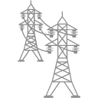
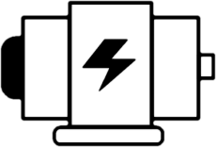

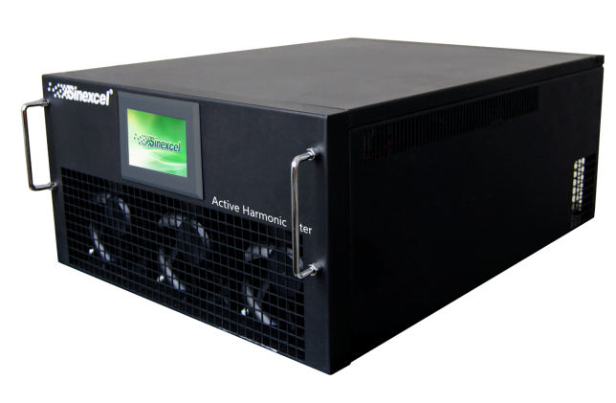
02
Grid current
1
External CT detects load current
3
AHF outputs the same amplitude
opposite polarity compensation current
I_{c}
1 3 5 7 9 11 n
Compensation current
Load current
2
AHF calculates harmonic current
Harmonic current

Slide 6
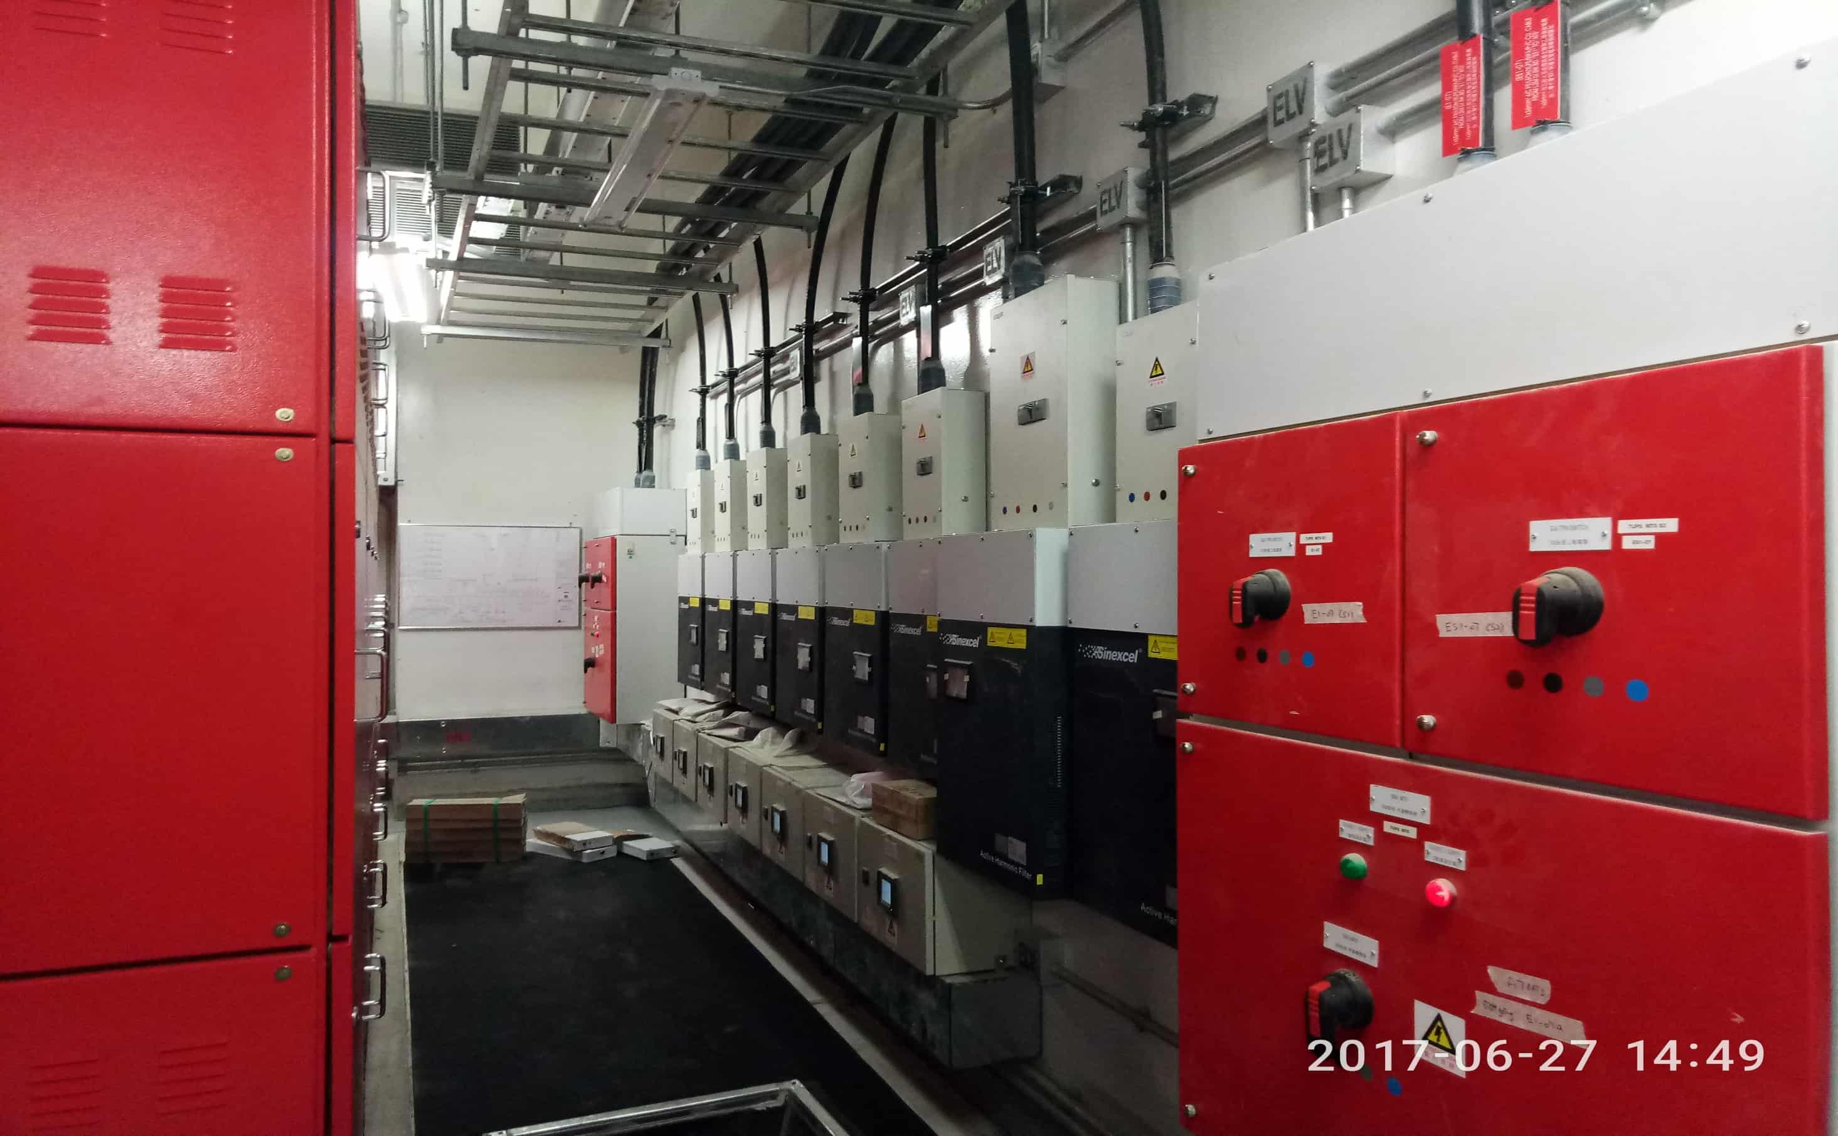
02
Advantage of AHF
Based on Power Electronics technology
Pioneering and Leading Modular Design, easy engineering
3-Level Topology to realize excellent harmonic mitigation performance, meet IEEE519 standard
Unique Intelligent Fast Fourier Transform for resonance management, high reliability harmonic mitigation performance

Slide 7
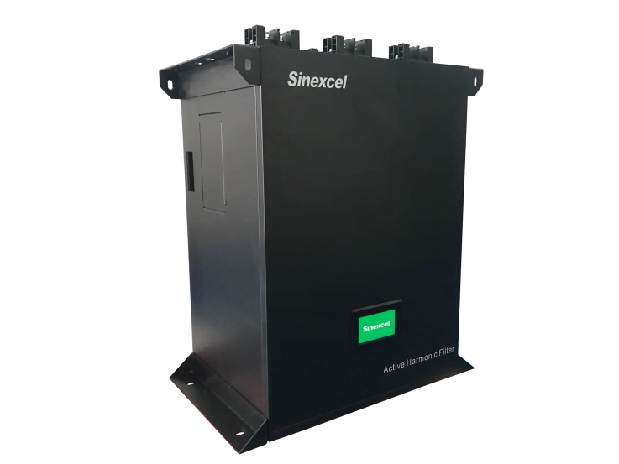
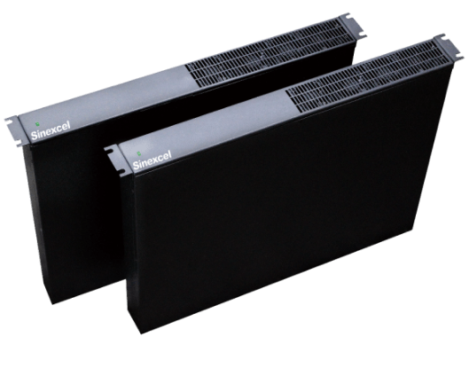
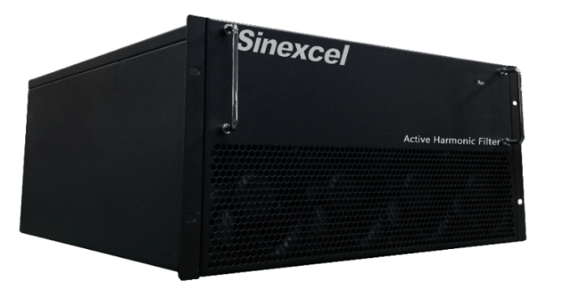
02
Product Range
Active Harmonic Filter
Rated Voltage
Rated Capacity
Rated Frequency
400V/480V/600V/690V
5A/10A/15A/25A/35A/50A/60A
75A/90A/100A/150A/300A
50Hz/60Hz
Notes:
Rack mounted/Wall mounted
with/without 4.3inch HMI/ 7 inch HMI
3p3w/3p4w
with/ without dry contact

Slide 8


Eco Building
Singapore
Marina Bay Financial Center Tower, AHF 5000A+
Notes:
Noted：Singapore, CBD Skyscraper Applications, Marina Bay Financial Center Tower, Asia Square Tower, Ocean Financial Center, Keepel Bay Tower, South Beach Tower, Metropolis Tower, Guoco Tower, Duo Tower for the top companies of the world PWC International, Hewlett Packard, Oracle, ABN AMRO Bank, Google, Boeing, lighting, UPS, VFD, harmonic of commercial building

Slide 9
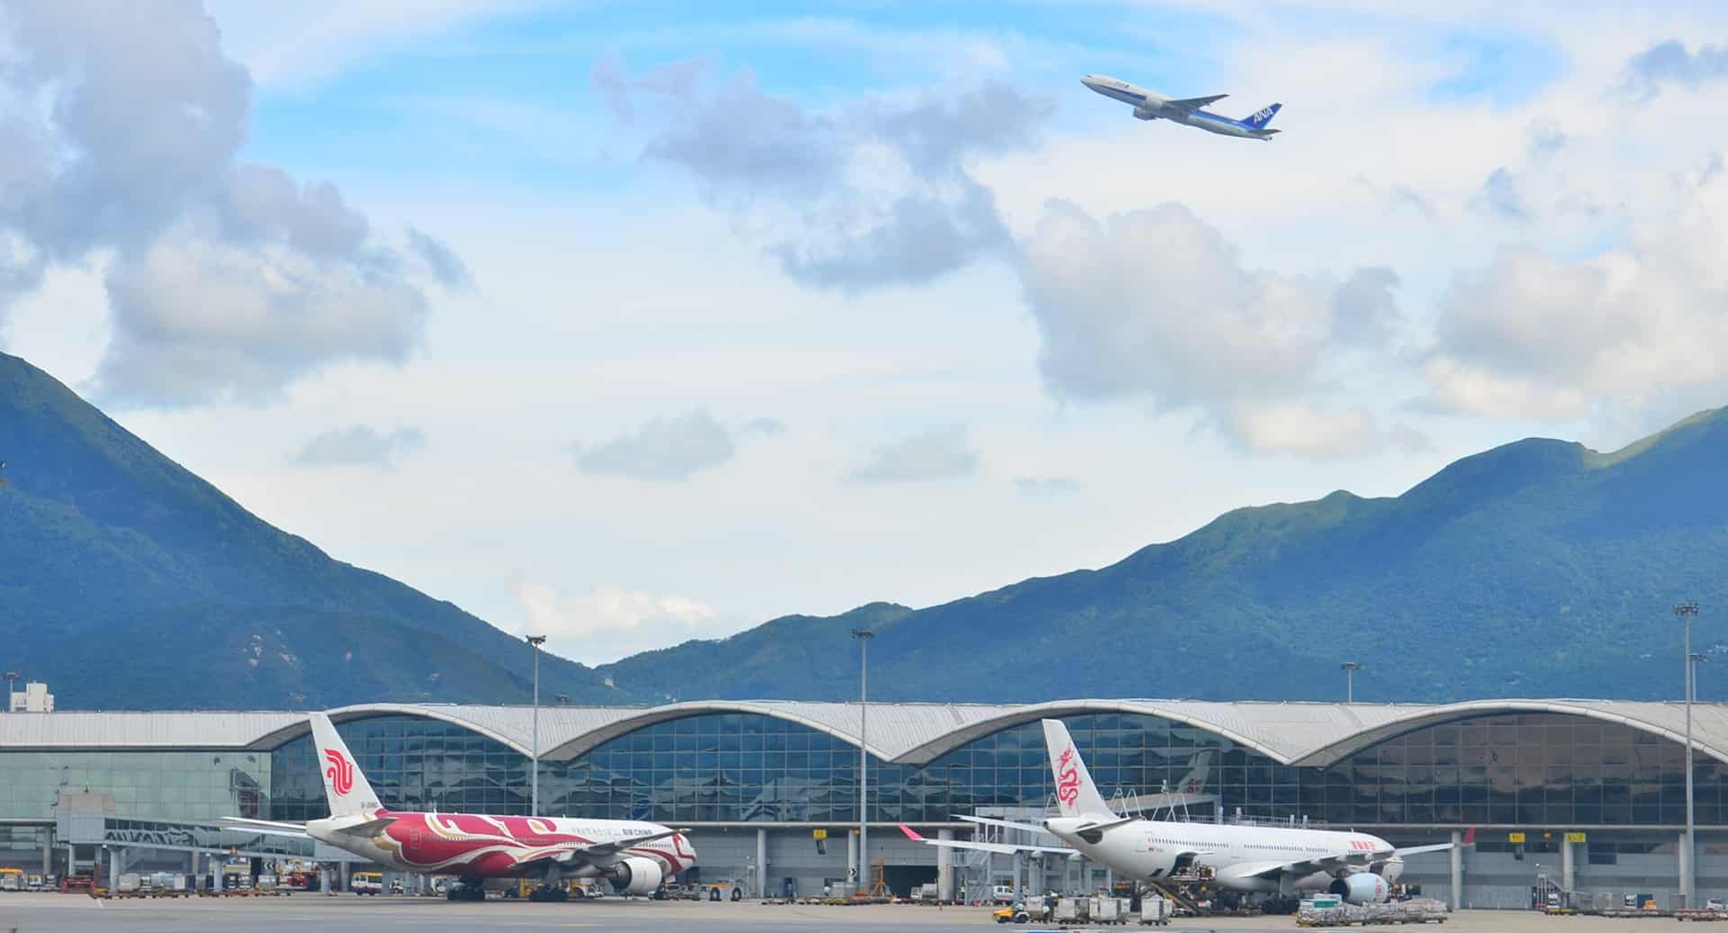



Infrastructure
Hong Kong(China)
Singapore
Dubai
Sweden
International Airport, AHF 5000A+ Changi Airport, AHF 150A Dubai airport, AHF 700A Goteborg Airport, SVG 270kVAr
Notes:
Hongkong Airport 5000A, Singapore Airport, 150A, Dubai Airport, 700A， Goteborg Airport，270kVar PFC by inverter based PQ

Slide 10


Infrastructure
Australia
Sydney Opera house, AHF 200A

Slide 11




Industrial
The United Kingdom
Canada
Glabina cheese, AHF 350A
Hylife Food,1440A
Notes:
芝士工厂：VFD驱动热泵

Slide 12
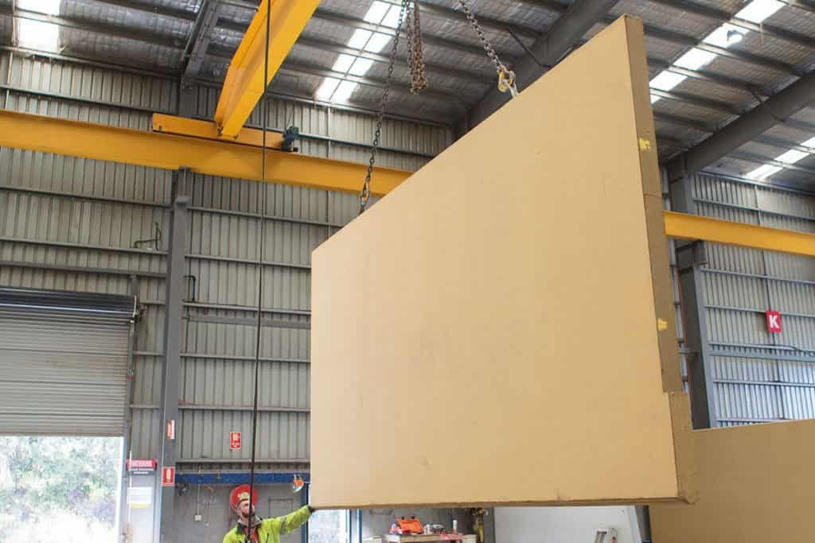

Industrial
Netherlands
Trespa cladding panel manufacture, AHF 400A
Notes:
覆面镶板工厂（外墙面板/瓷砖之类）

Slide 13
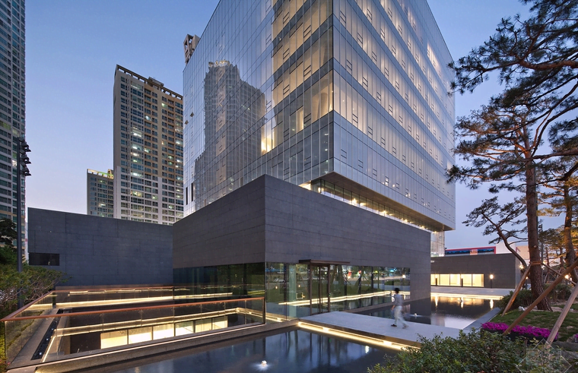

IDC
South Korea
Hong Kong(China)
Singapore
Daegu bank, AHF 150A/ SVG 400kVAr
China Unicom Data Centre, AHF 4425A
Oracle Singapore, AHF 580A

Slide 14
03
Inverter Based PQ-A Revolution Power Factor Correction Technology
Static Var Generator

Slide 15
03
How does reactive power come from?
What are the impacts of reactive power?
U
i
Penality from utility
Resistive Load
Current fully in phase with the voltage
Waste of transformer capacity
i
U
U
φ
i
φ
Cable heat loss
Inductive Load
Current is lagging to voltage in phase
Capacitive Load
Current is leading to voltage in phase
As many electrical equipment are based on the principle of electromagnetic induction, such as transformers, motors.
Reactive power is generated to establish an alternating magnetic field and induced flux.
Notes:
Noted：Reactive power is generated when power is drawn from the supply network and then fed back into the network with a time delay.
无功功率比较抽象，它是用于电路内电场与磁场，并用来在电气设备中建立和维持磁场的电功率。凡是有电磁线圈的电气设备，要建立磁场，就要消耗无功功率。(建立交变磁场和感应磁通所需的电能称为无功功率)
比如40W的日光灯，除需40W有功功率(镇流器也需消耗一部分有功功率)来发光外，还需80VAr左右的无功功率供镇流器的线圈建立交变磁场用。由于它对外不做功，才被称之为"无功"。
电机需要无功功率建立工作磁场（励磁），这部分无功功率可以通过输电网络从系统获取，也可以通过就地补偿的容性补偿装置获取，就地补偿后大大减少了与系统的功率交换，降低了交换过程输电网络产生的能量损耗提高了功率因数。
PS：感性设备发出感性无功消耗容性无功，容性设备发出容性无功消耗感性无功，无功本身不消耗能量，但传输会引起损耗。

Slide 16
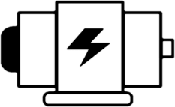

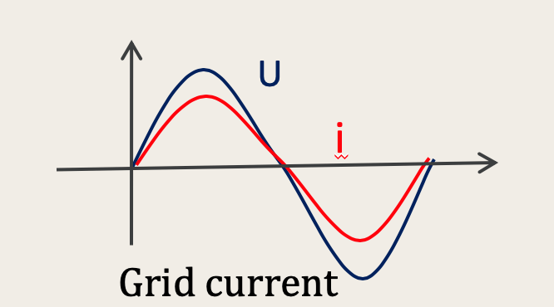
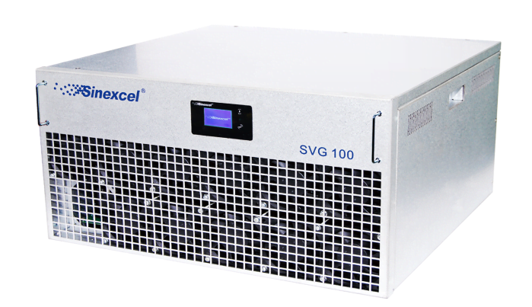
03
U
i
Grid current
3
1
2
Power Factor at grid incoming
SVG Output
U
i
i
φ
Load is inductive
φ
Lagging current
i
i
U
Load is Capacitive
φ
φ
Leading current
SVG works as a dynamic reactive power source.
According to the gird system, it can provide capacitive reactive power,
or absorb redundant inductive reactive power of the power grid.
Notes:
Noted: SVG是一个动态的无功源。根据接入电网的需求，它可以向电网提供容性无功，也可以吸收电网多余的感性无功

Slide 17
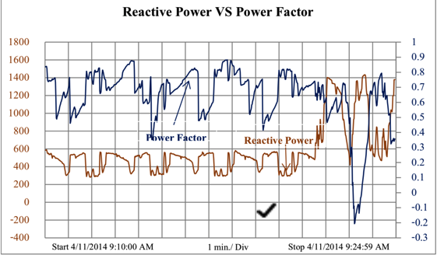
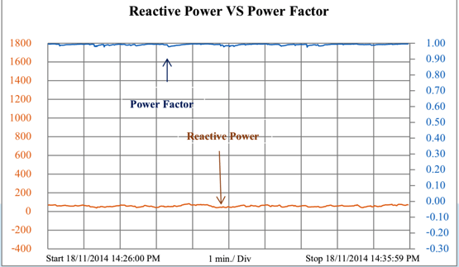
High reliability performance can sustain in high harmonic environment
Step-less compensation to reach Cosφ 0.99
15ms full process PFC for dynamic load current
Bi-Directional PFC for lagging and leading reactive power

Slide 18
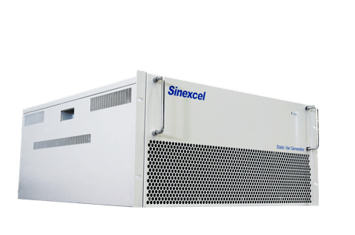
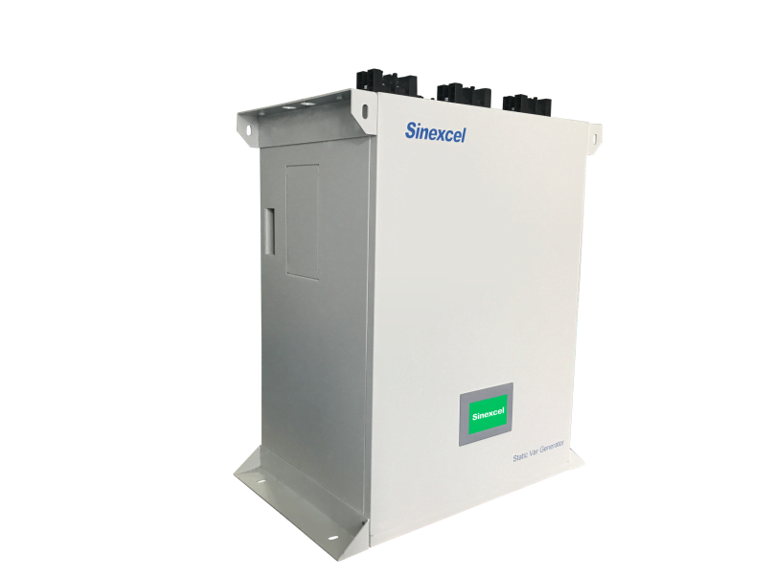
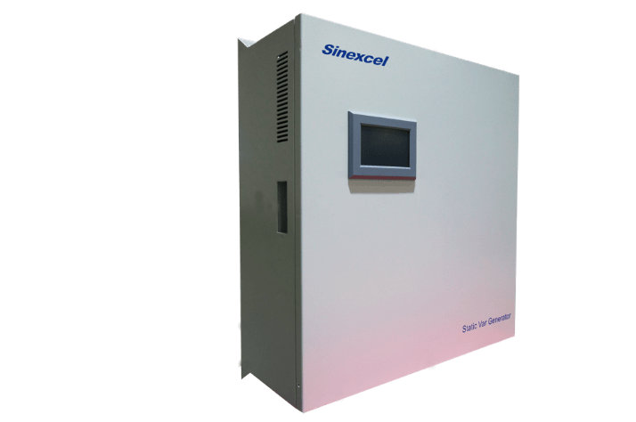
03
Product Range
Static VAr Generator
Rated Voltage
Rated Capacity
Rated Frequency
400V/480V/600V/690V
30/50/75/90/100/120
200/480/600/690kVAr
50Hz/60Hz

Slide 19
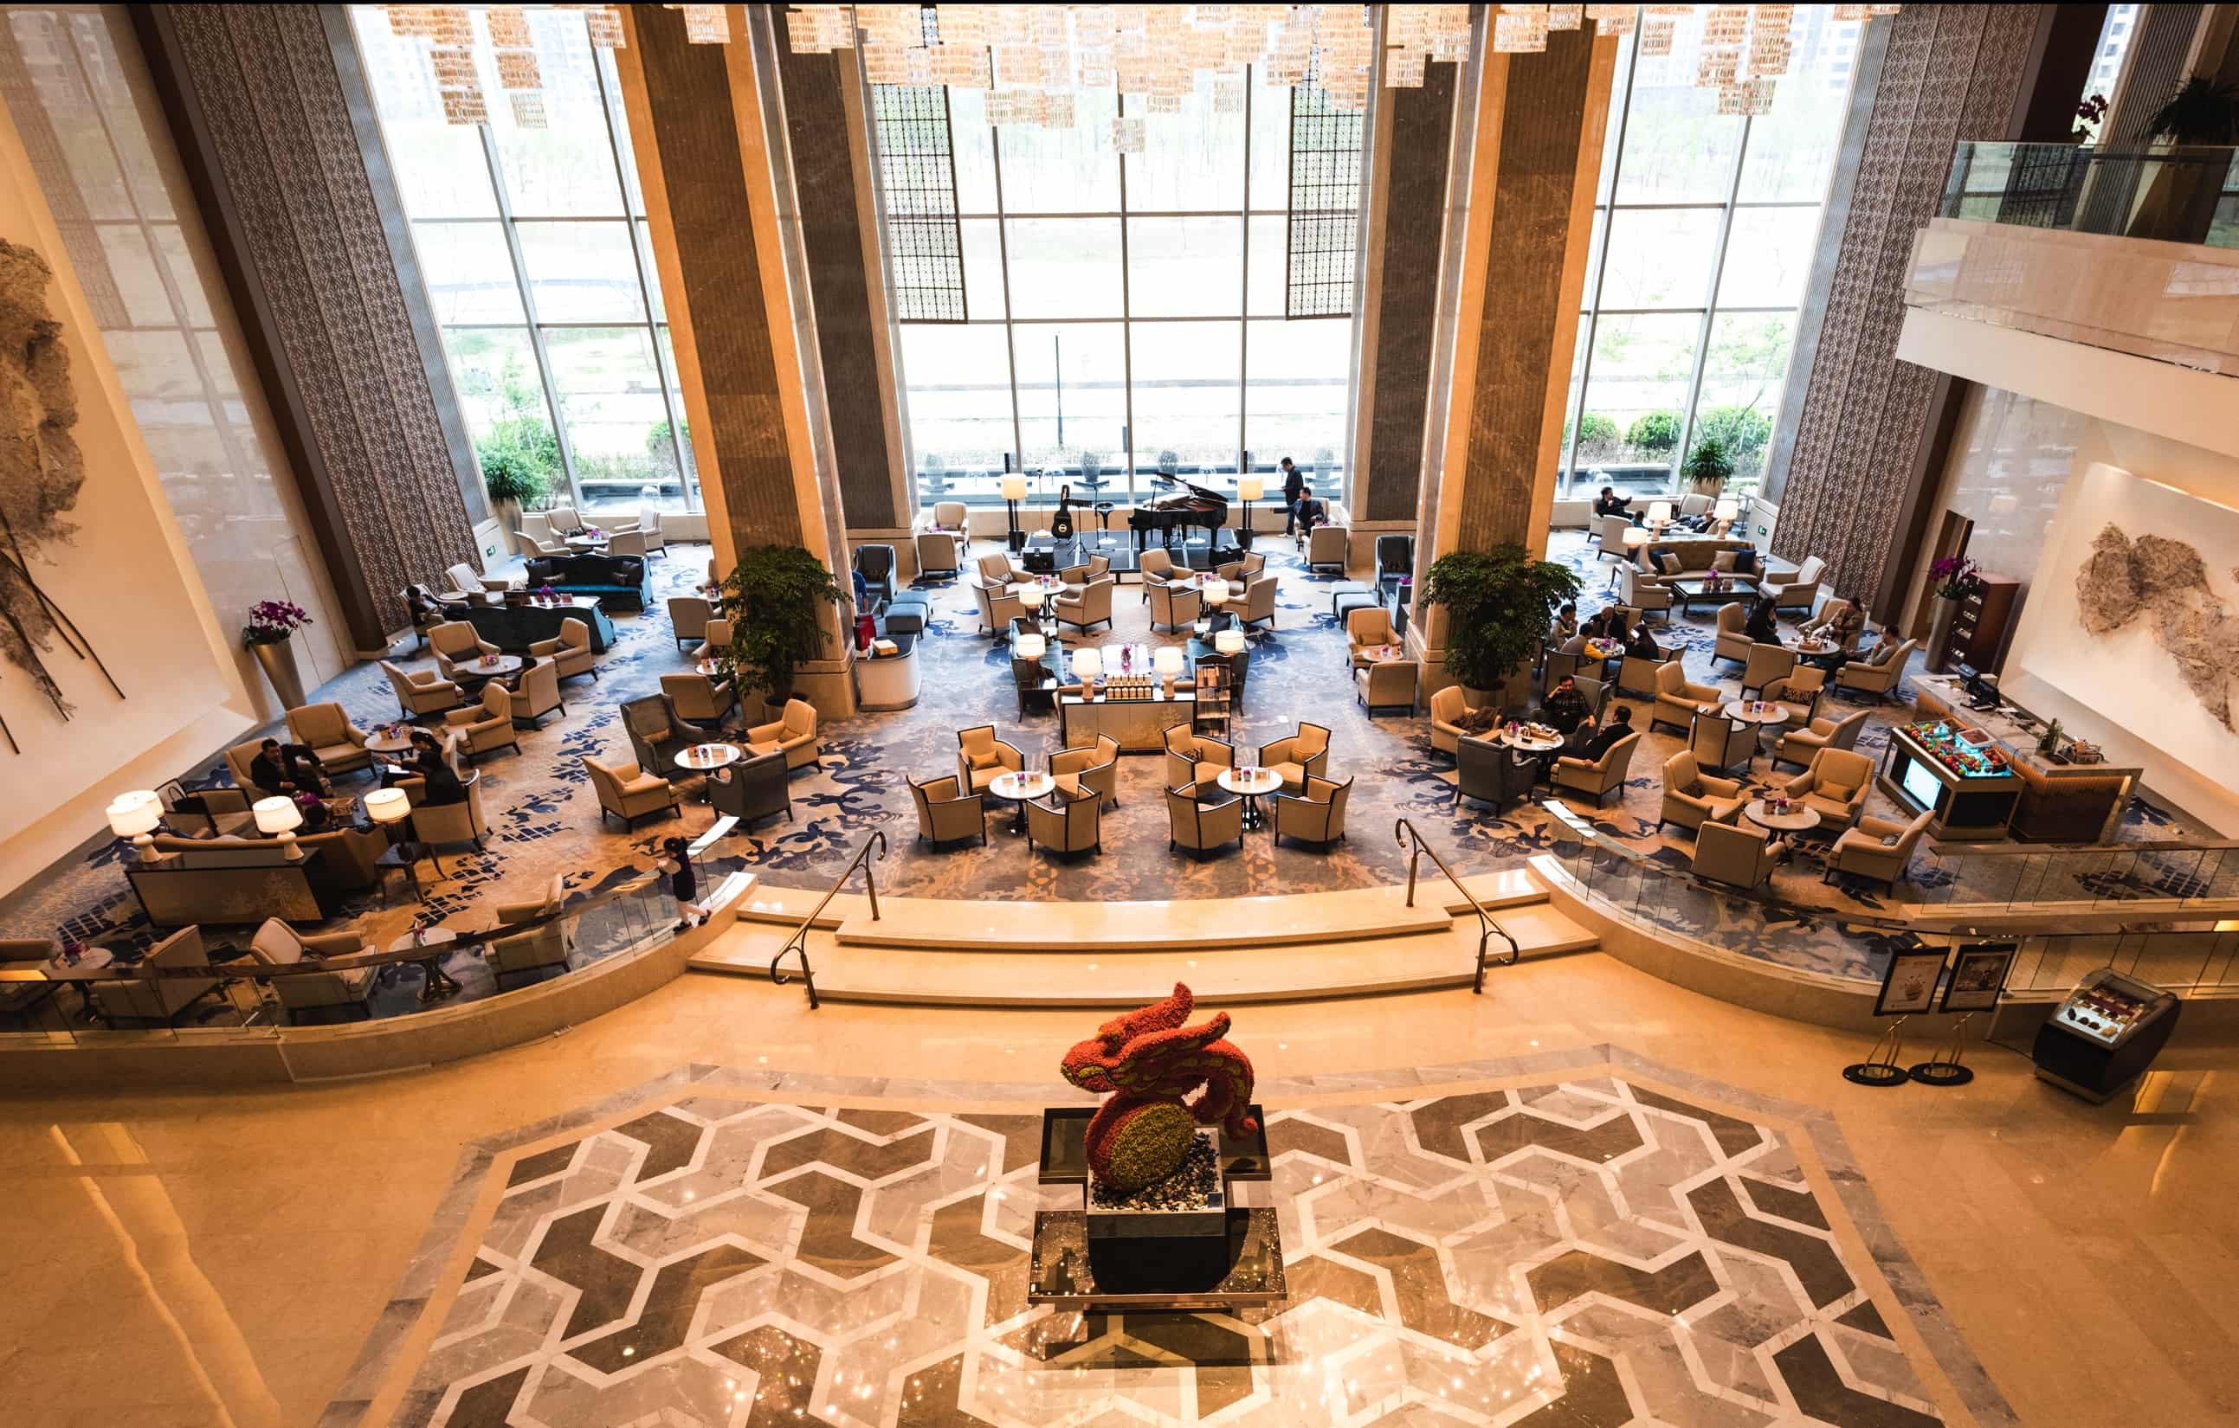

Eco Building
South Korea
Hong Kong(China)
Parnars Hotel, SVG 1550kVAr
Far East Finance Centre, SVG 100kVAr
Notes:
Noted: HVAC system (Heat, Ventilation, Air conditioner, Chiller )

Slide 20
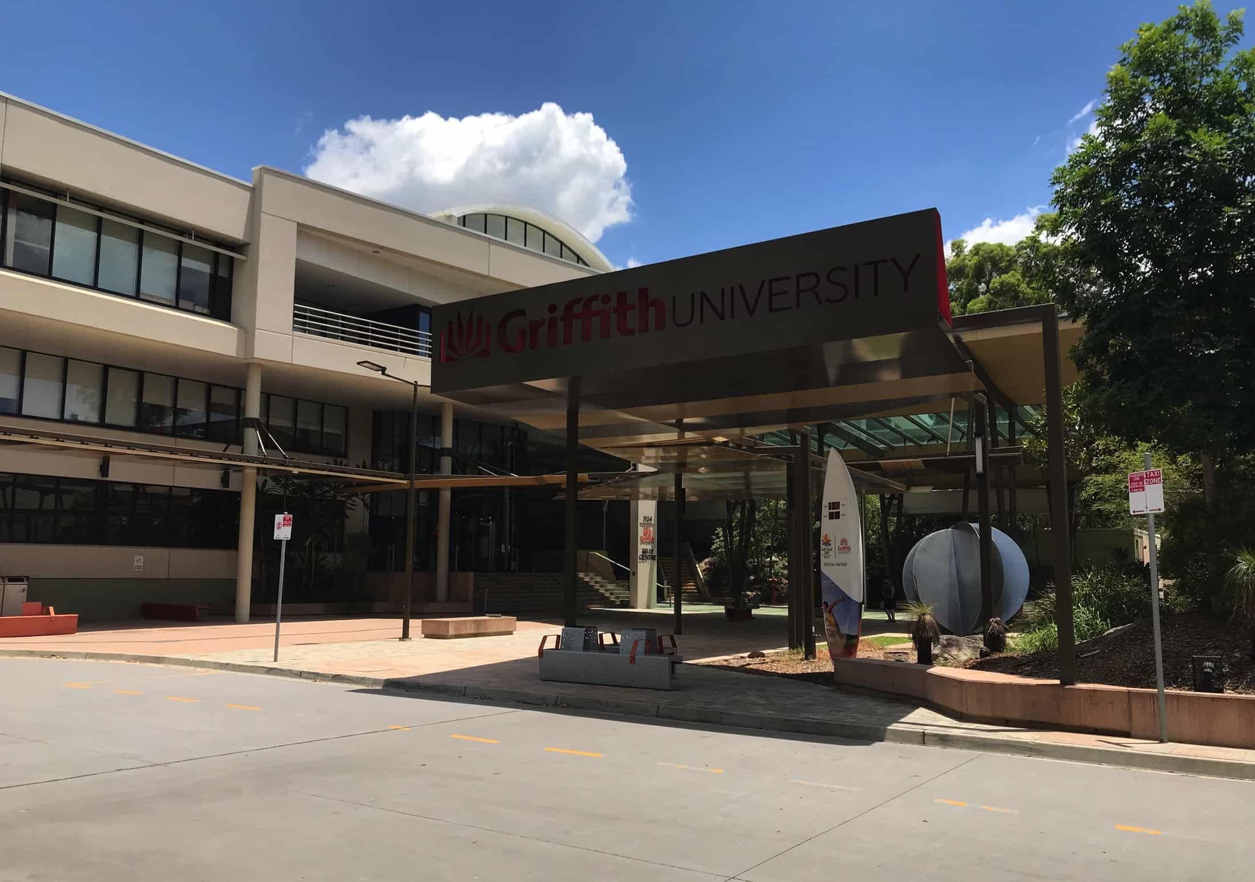

Infrastructure
Australia
Colombia
Griffith University, SVG 4300kVAr
Chicamocha National Park, SVG 150kVAr
Notes:
Noted: Infrastructure——1. 澳大利亚大学A beautiful campus at Brisbane, nearby Gold Coast, 5000+kVAr SVG dispersive, convenient engineering, space saving installation, saving electricity, support the campus operating at high energy efficiency 2. 国家公园 负载：cable

Slide 21
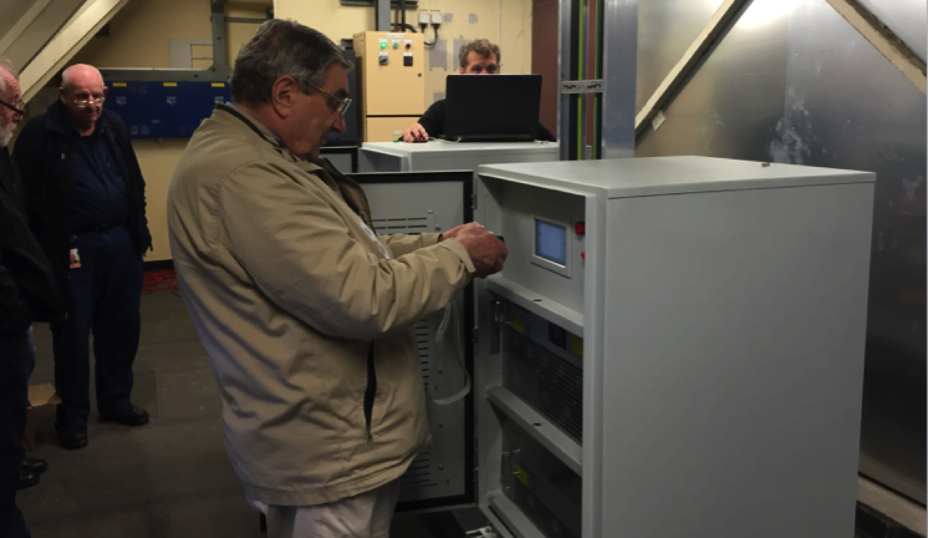

Industrial
New Zealand
Parliament Library，SVG 200kVAr
Notes:
John Fulton was taking photo for SVG performance, because he be surprised at the consistent Cos fi 0.99 by SVG

Slide 22
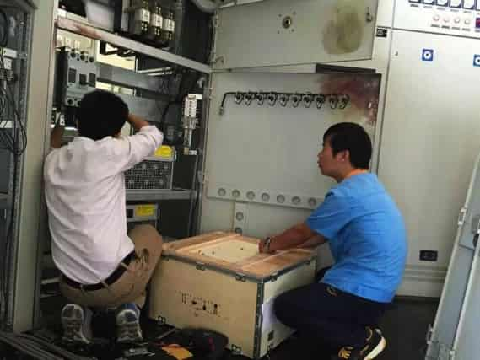
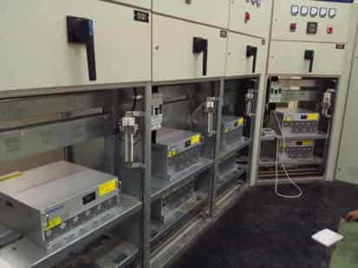

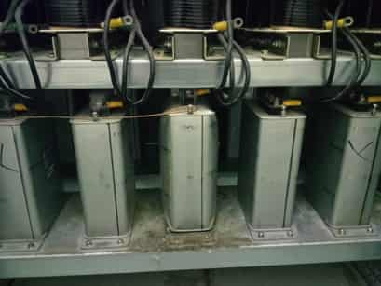
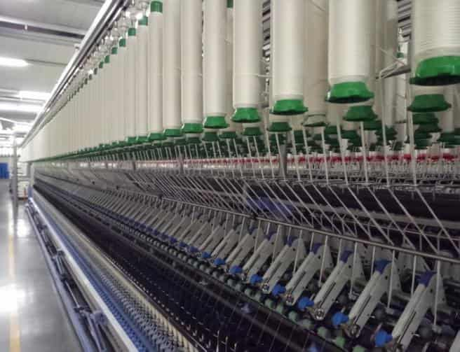
Industrial
Vietnam
Texhong textile factory, SVG 50000kVAr+
High harmonic environment, Cap banks burnt out, put Sinexcel SVG into Capacitors cabinet to do Power factor correction.
,
Notes:
Noted: Industrial Manufacturing Hundreds VFDs generate harmonic overlaying a complicated harmonic current environment, SVG runs with reliability more than 4 years

Slide 23




Industrial
Coca Cola
China, SVG 150kVAr Turkey, SVG 200kVAr Fiji, , SVG 200kVAr
,
Notes:
Noted: Industrial Manufacturing Hundreds VFDs generate harmonic overlaying a complicated harmonic current environment, SVG runs with reliability more than 4 years

Slide 24
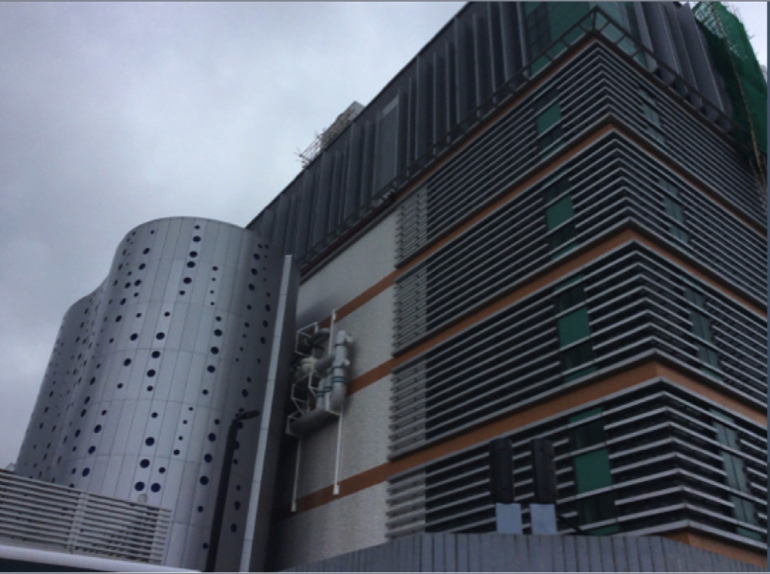

IDC
Hongkong(China)
South Korea
NTT Data Center, SVG 3500kVAr
LG Plus, SVG 3300kVAr
Notes:
Noted: Data Center——Leading IDC operator, Fortune global 100 companies, 3500kVAr SVG supporting this NTT data center operating in Hongkong, Microsoft, America Stock market’s data in Asia all running at this data center

Slide 25
04
Voltage Sag Recover- ideal solution for deep and short time voltage sag
Real-time Active voltage conditioner

Slide 26
04
Definition
1.5
Voltage sag
Specified by IEEE standard is the voltage RMS is temporarily reduced to 10% ~ 90% of the rated voltage and lasts for 10ms ~ 1min. (normally within 2s)
Short term interruption
Voltage of one or more phases is reduced to less than 10% instantaneously and the duration is 3s~1min.
Voltage Depth
1.0
0.5
0.0
-0.5
-1.0
-1.5
0.00
0.05
0.10
0.15
Duration(s)
Voltage Depth
1.5
1.0
0.5
0.0
-0.5
-1.0
-1.5
0.00
0.05
0.10
0.15
Duration(s)

Slide 27
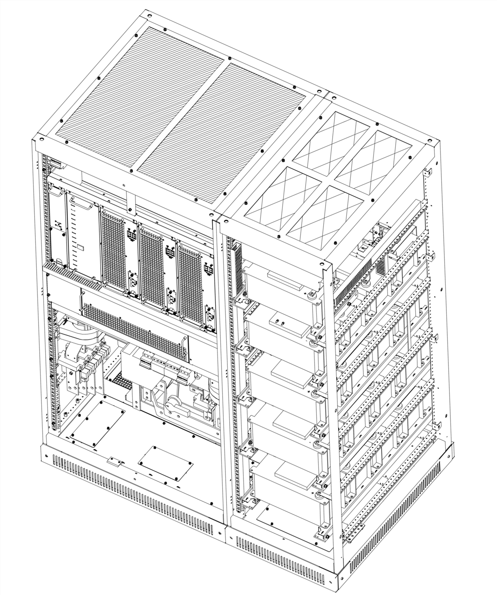



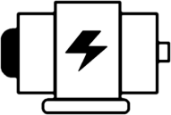










04
Working principle
Real-time Active voltage conditioner
1
Control module
Inverter
Grid
Load
Thyristor module
3
Isolation transformer
Inverter
2
Super capacitor
Thyristor module
Super capacitor
1. Grid voltage is normal
AVC-RTS standby, super capacitor is in full charged. Load is supported by grid.
2. Voltage sag happens
Grid voltage is isolated from the load. Load is supported by super capacitor.
3. Grid voltage returns to normal value,
AVC-RTS stops working and the super capacitor begins to charge. Load is supported by grid.

Slide 28
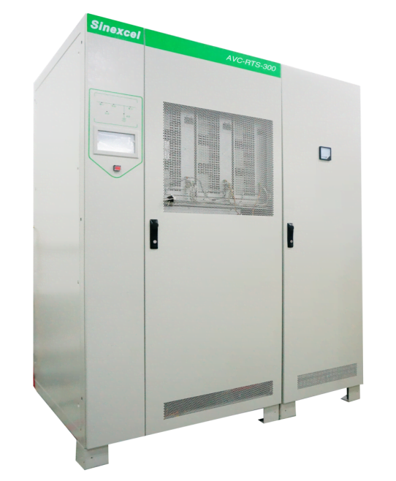
04
Product Range
Active Voltage Conditioner
Rated Voltage
Rated Capacity
Rated Frequency
208V/220V/380V/400V/415V/460V/480V
50/60/150/300/450
600/900/1200/1500/1800/2400kVA
50Hz/60Hz

Slide 29
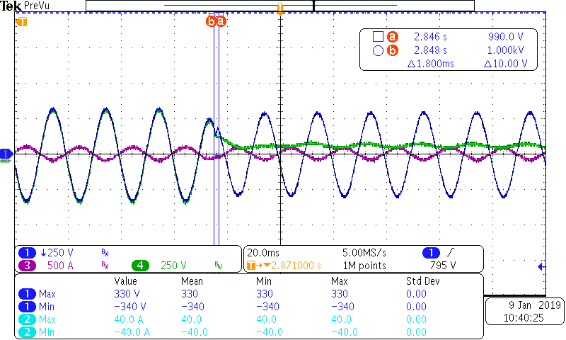
04
AVC Advantage
Response time:1.8ms
Only 1% energy consumption
Low maintenance cost no need air conditioning cooling, no need energy storage component maintenance
5ms full working process time, with 0-130% voltage sag protection, high reliability solution
voltage sag happens
AVC fully support the load
Grid output voltage
Load voltage
Load current

Slide 30
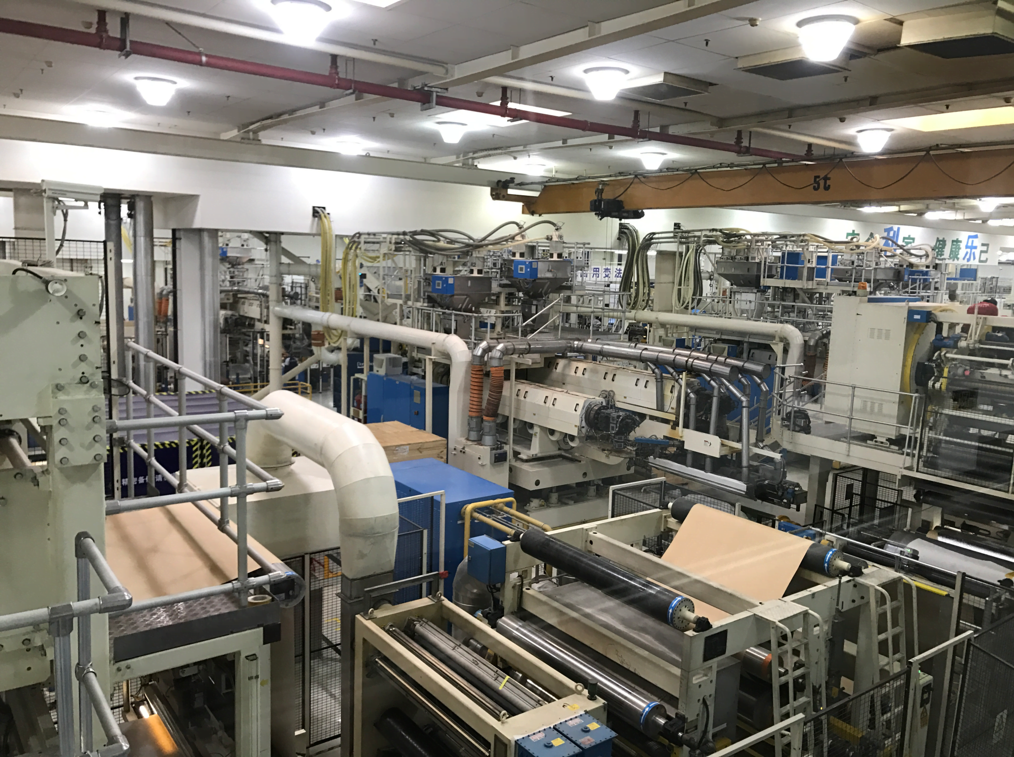
Industrial Manufacturing
Tetra Pak
Requirement:
EPS6-200A PICCO load
▲The main loads are production equipment such as the laminating machines, cooling water pumps and printers which are driven by AC motors.
▲Affected by thunderstorm, there are more than 10 voltage sag events per year.
Notes:
Noted:
Project：Inner Mongolia-Beverage packaging factory （Tetra Pac 总部瑞典）
Product: Sinexcel AVC - RTS 300KVA 2 Sets

Slide 31
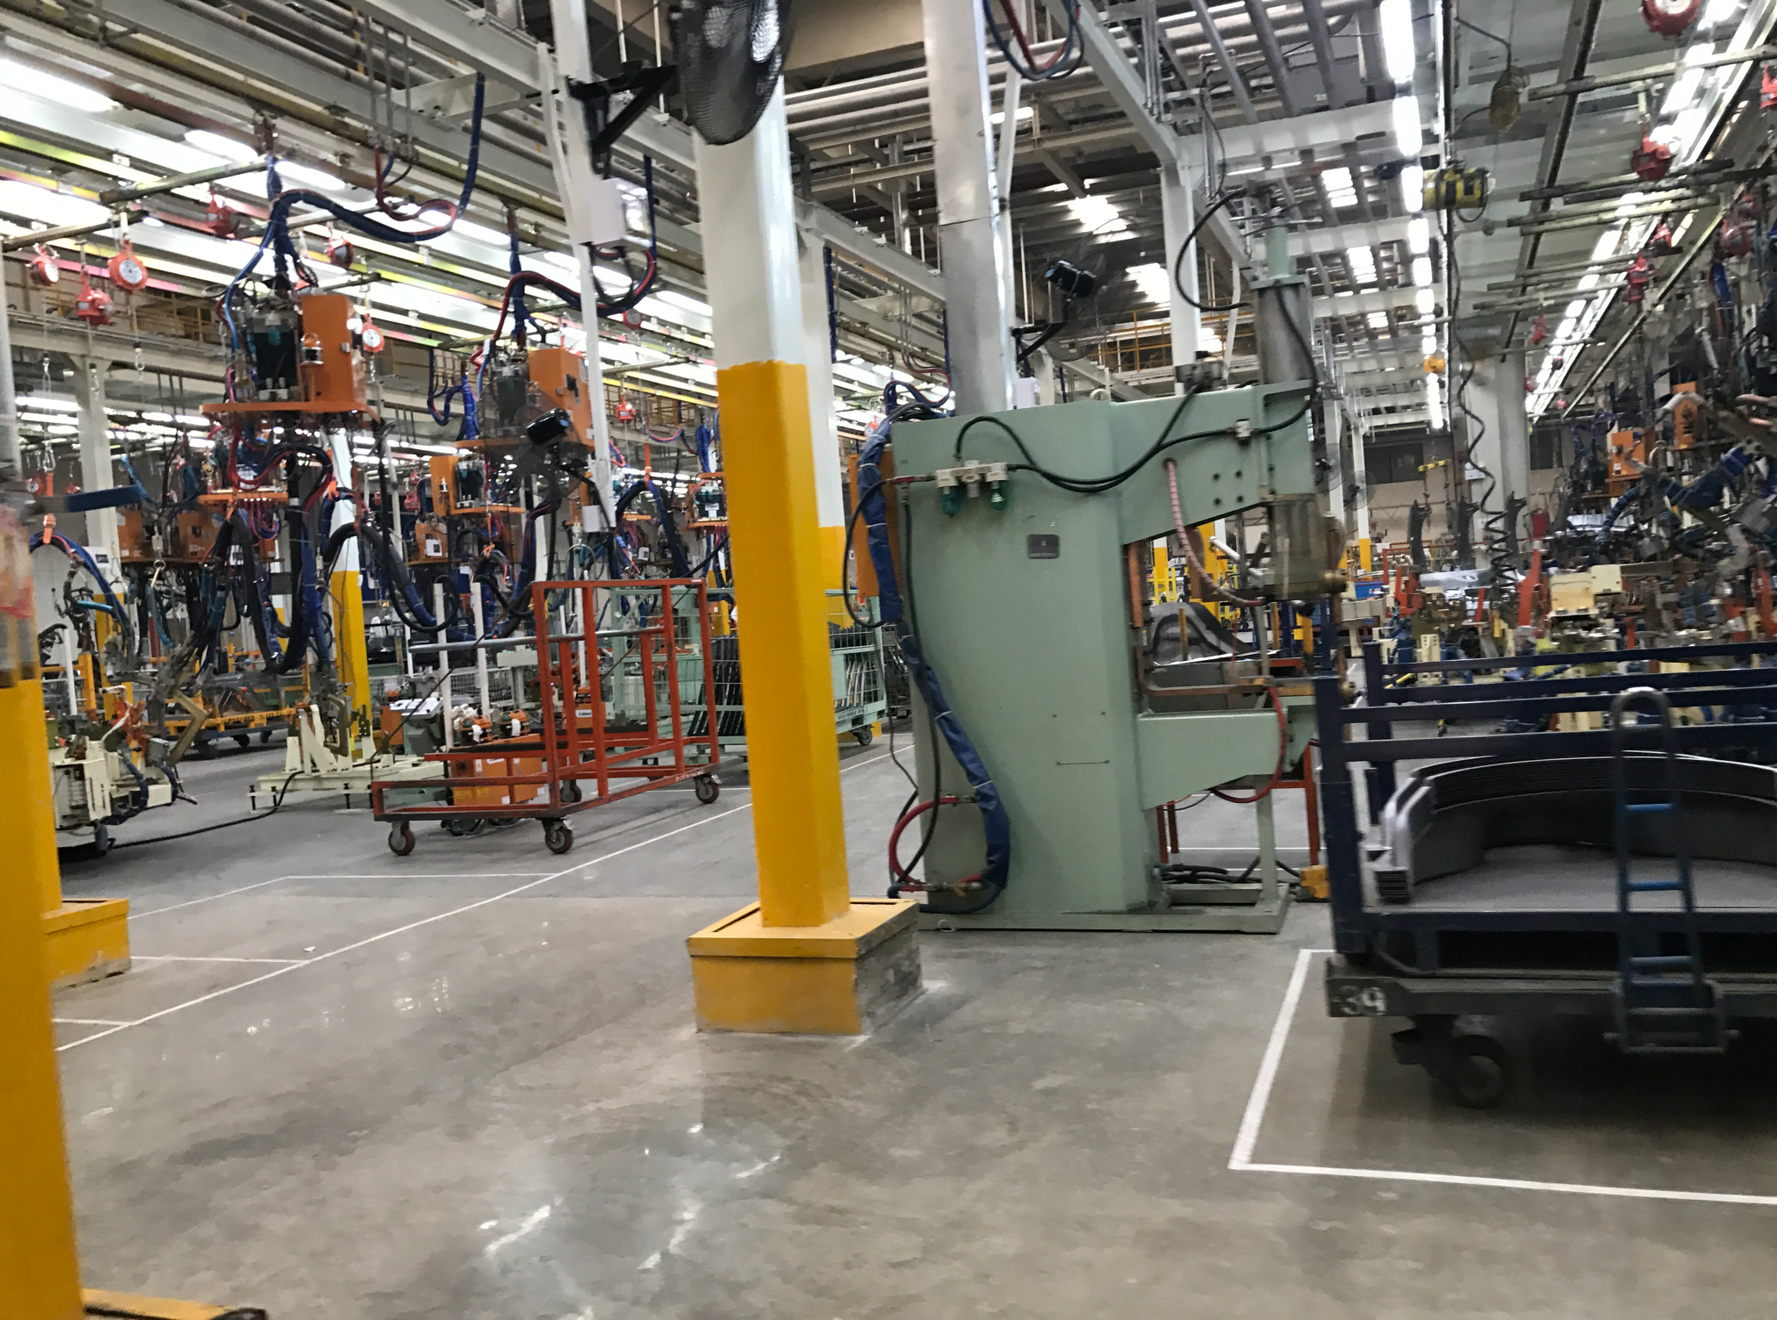
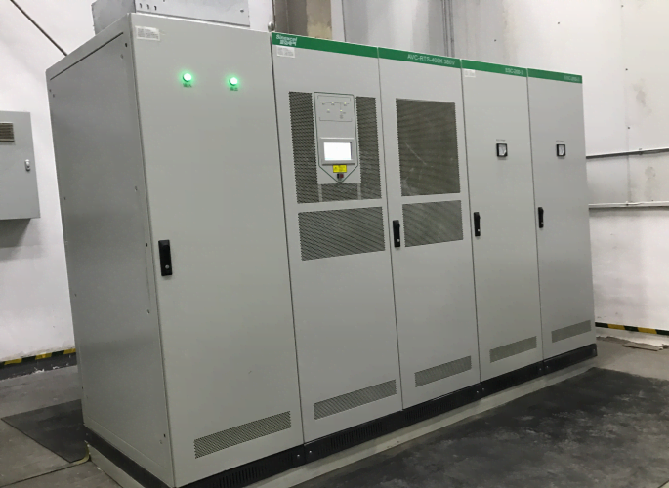
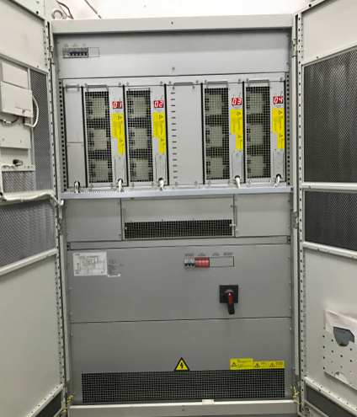
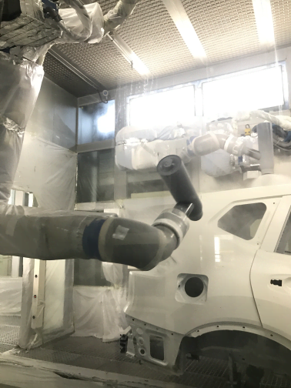
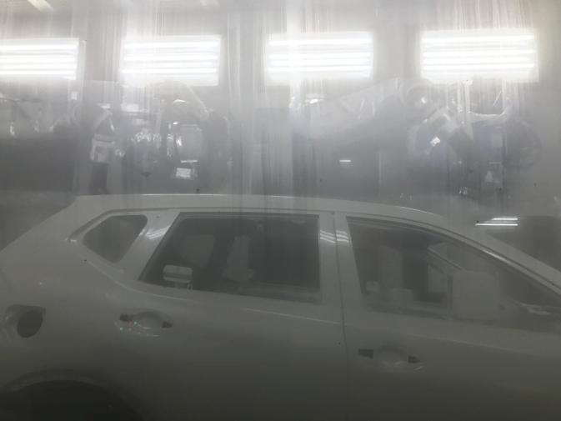
Industrial Manufacturing
Nissan Motor
Requirement:
Painting robot/Air purifier
▲In the case of voltage drop, it seriously affects the
normal operation of plant equipment, leading to
waste of raw materials and affecting product delivery.
▲In this project, sensitive equipment, namely the
paint line, painting robots and air purifier in the intermediate coating paint shop are protected by
Sinexcel AVC-RTS.
Notes:
Noted:
Project: Guangzhou/Zhengzhou-Dongfeng Nissan Car factory
Product: Sinexcel AVC - RTS 50KVA/4 Sets; 60KVA/5 Sets; 400KVA/1 Set

Slide 32
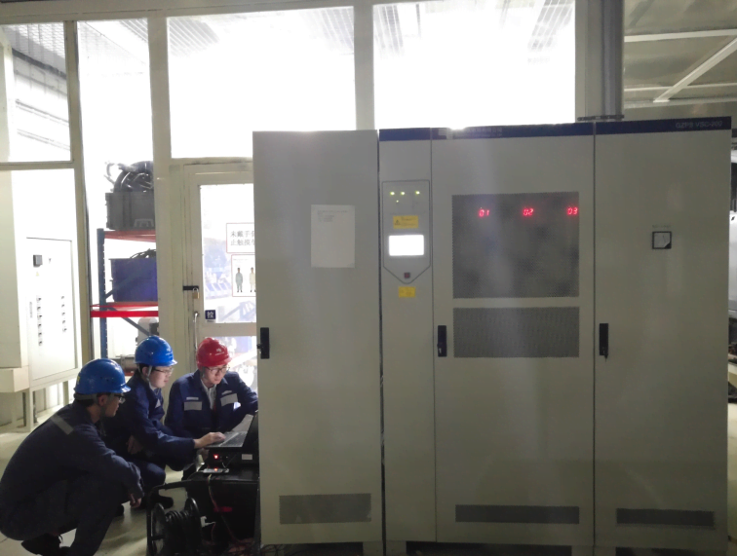
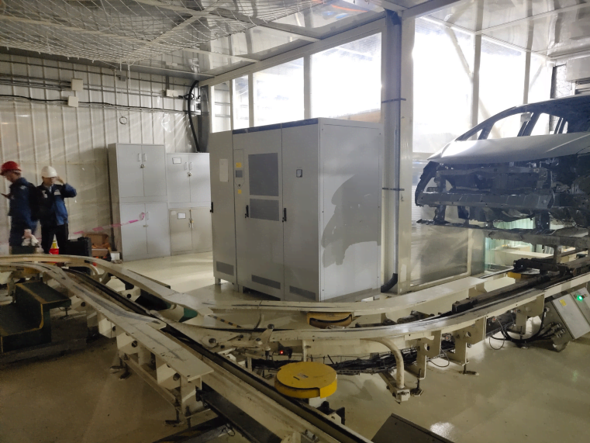
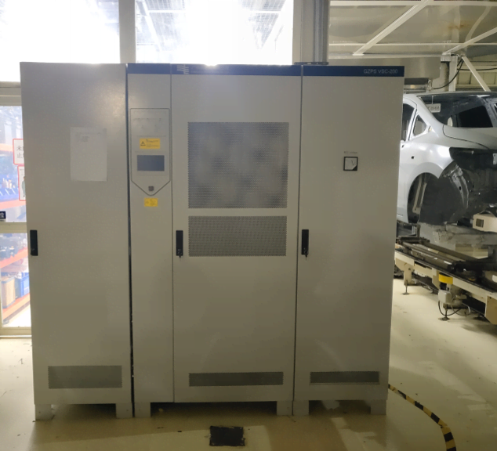
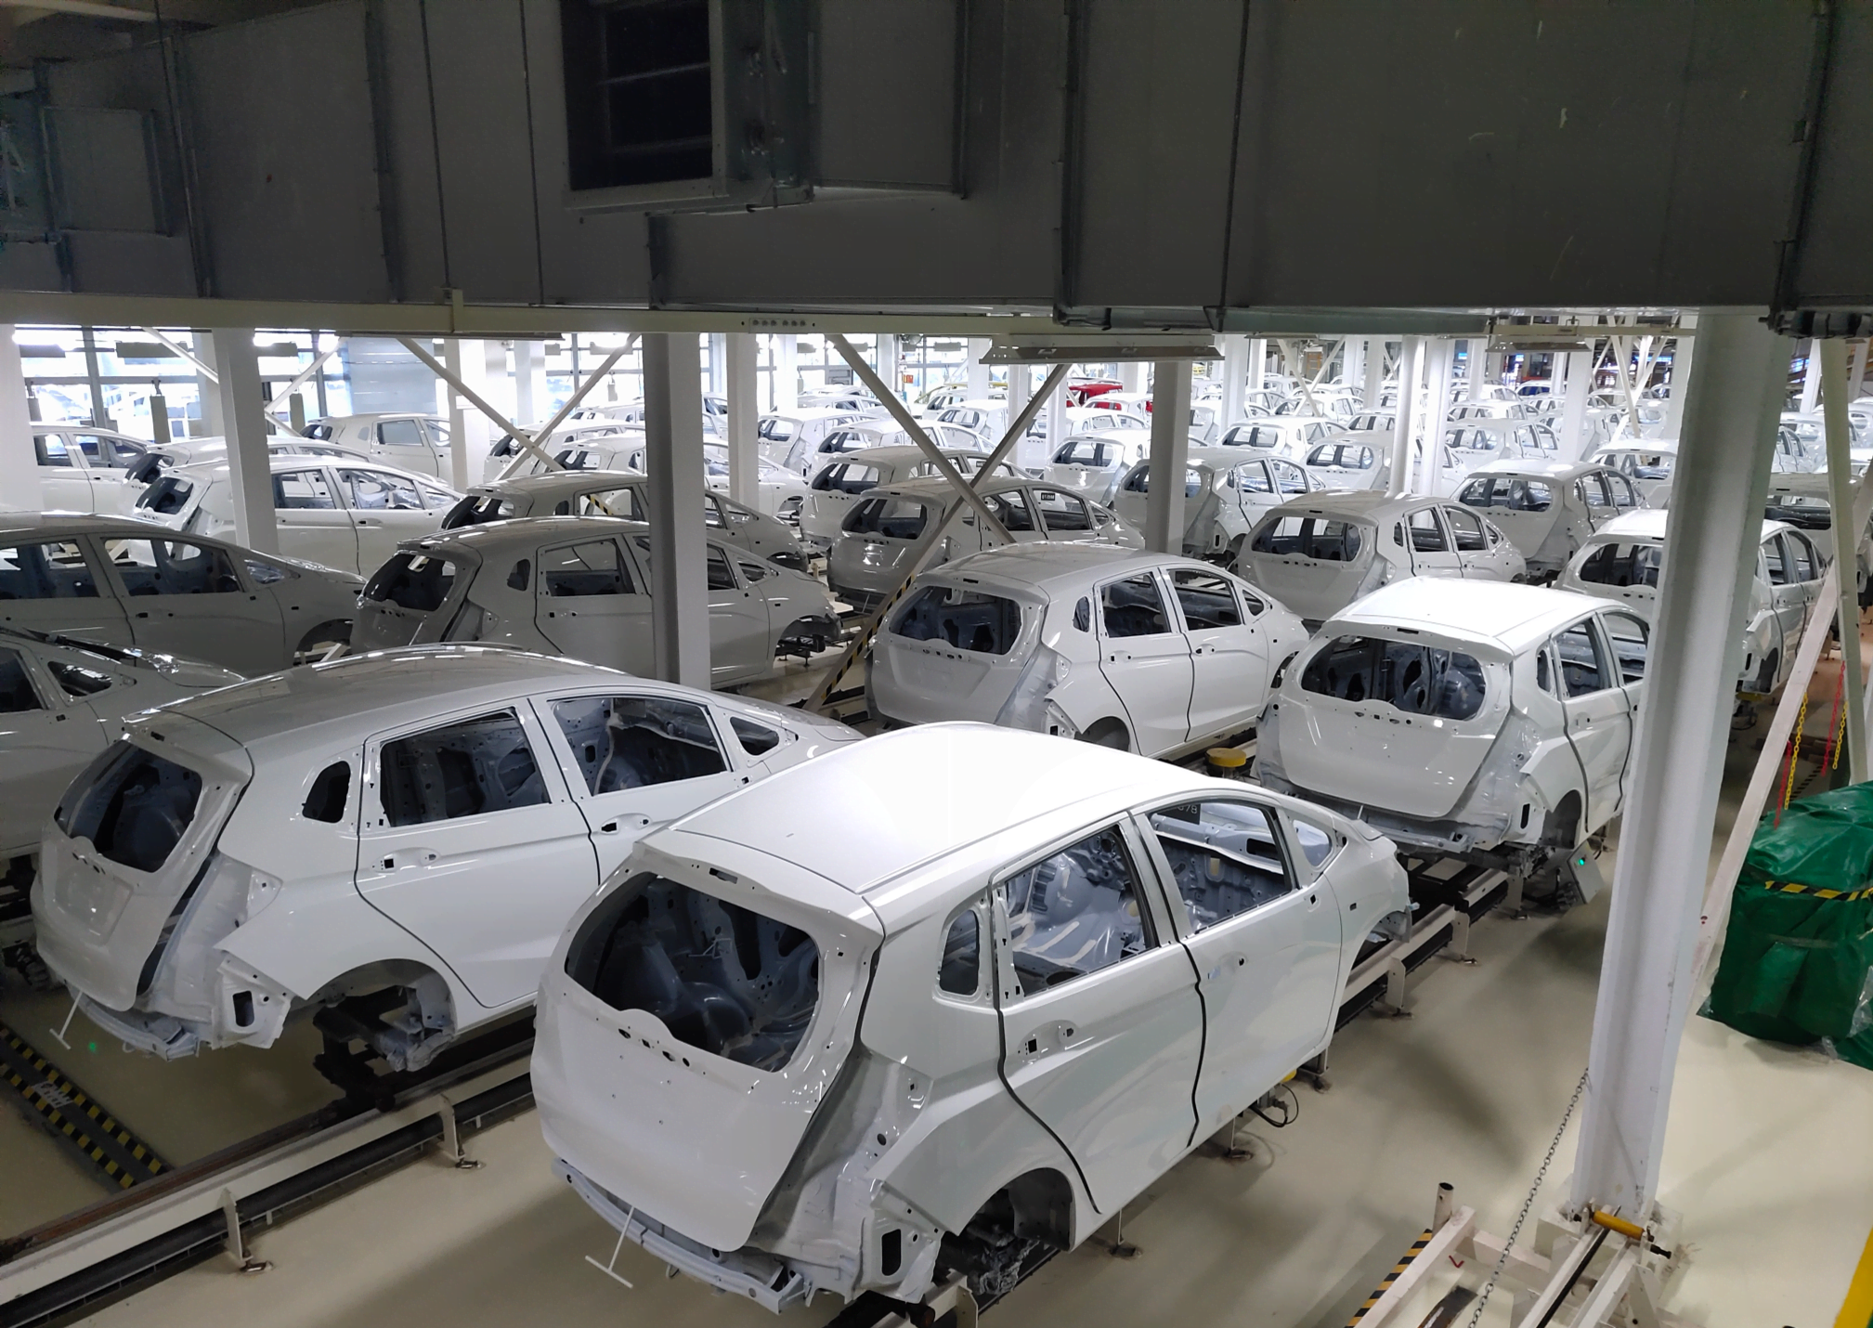
Industrial Manufacturing
Honda Motor
Requirement: Painting robot
▲The sag makes the paint line stop suddenly, and it takes a long time to clean up the air control system before the furnace control is restarted.
▲Much of the downtime resulting from the sag is spent restarting the entire production line.
Notes:
Noted:
Product: Sinexcel AVC - RTS 200KVA

Slide 33
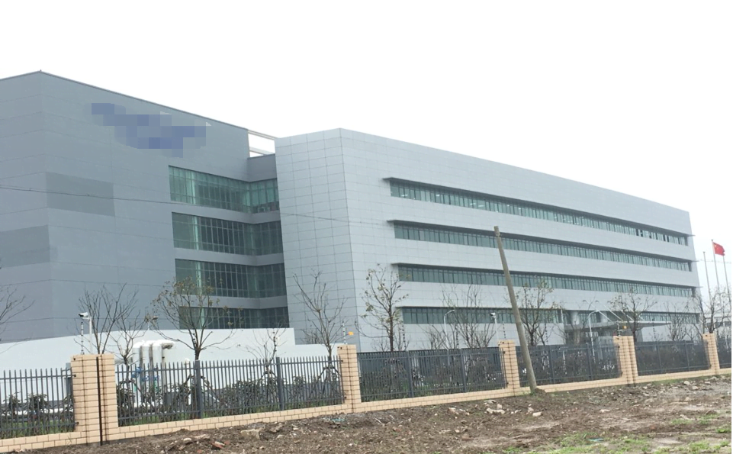
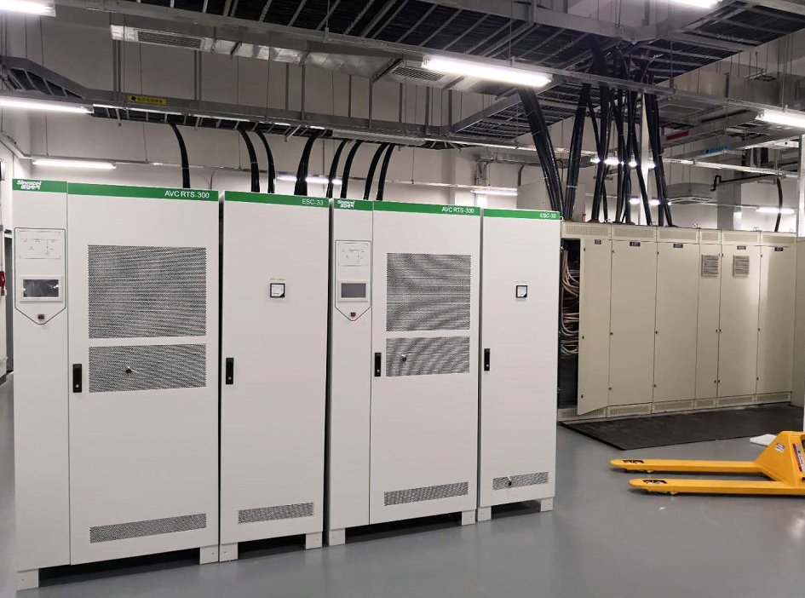
Industrial Manufacturing
Semiconductor Manufacturer
Requirement:
Double-sided polishing machine of DSP
▲Most equipment on site belong to high precision instruments.Voltage sag will lead to shutdown of production line equipment, resulting in production reduction.
▲The raw materials of the line are damaged, the yield is reduced, and the loss is relatively large.
Notes:
产线上DSP双面抛光机

Slide 34

S
inexcel Electric
▪ Based on Power Electronics technology
▪ Devoted to low voltage Power Quality business

Slide 35
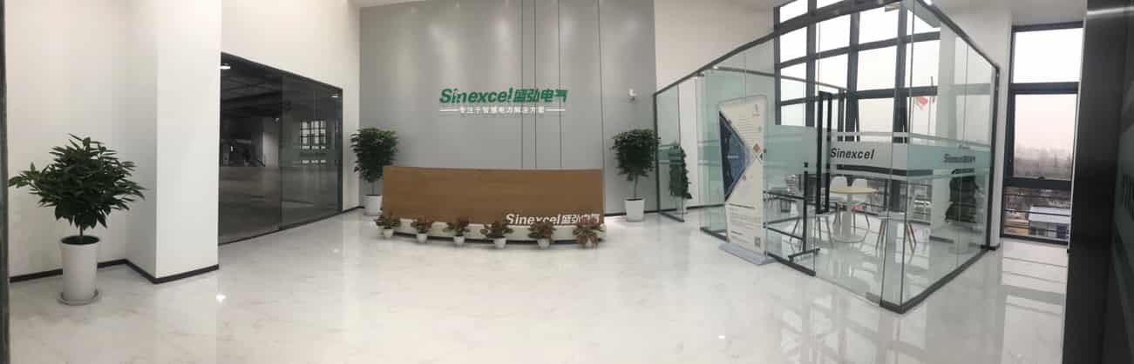
05
Stock Code 300693
Company financial information can be checked by Google
700 + employees, R&D staff >30%
Run business in more than 50 countries
Notes:
Noted：深圳百旺信总部基地 深圳湾超级办公室 西安盛弘研发中心 惠州盛弘制造中心 苏州盛弘制造中心 盛弘必思恩公司 全国二十多个工程师销售团队办事处
自主设计研发 超五十多个专利 全球销售网络
Established in 2007, went public in 2017 Headquartered in Shenzhen 700 + employees, R&D staff >30%
Global sales networks Certified by: CE ETL UL DNV RINA CCS etc 50多个专利证书

Slide 36
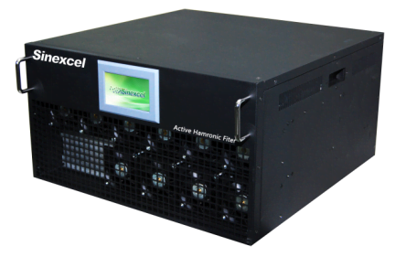
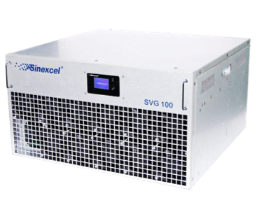
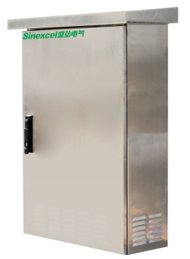
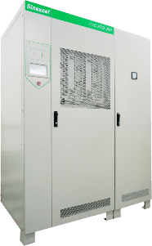
Rated Voltage
400V/480V/600V/690V
05
Product Range
Rated Capacity
5/10/15/25/35/50/60/75/90/100/150/300A
Rated Frequency
50Hz/60Hz
Sinexcel AHF
Harmonics
Rated Voltage
400V/480V/600V/690V
Current Quality
Reactive Power
Rated Capacity
30/50/100/200/480/600/690kVAr
Rated Frequency
50Hz/60Hz
Sinexcel SVG
Power Quality
Unbalance
Rated Voltage
400V
Rated Capacity
30kVAr/50kVAr/100kVAr/200kVAr
Voltage Quality
Voltage Sag
Rated Frequency
50Hz/60Hz
Sinexcel SPC
Rated Voltage
208V/220V/380V/400V/415V/460V/480V
Rated Capacity
50/60/150/300/450/600/900/1200/1500/1800/2400kVA
Rated Frequency
50Hz/60Hz
Sinexcel AVC-RTS
Notes:
SPC：SVG with IP44 cabinet

Slide 37
05
Global Reference
Millions amperes & Millions kVAr
Infrastructure
ECO building
Run business in more than 50 countries
Biggest inverter based Power Quality manufacturer in the world
Million Ampere
Million kVAr
Reference covers most of the industries with widest application
Airport-metro-railway
tunnel-water treatment
schools-museums-government building
Skyscraper-commercial building-shopping mall
apartments
Industrial
IDC
Food & beverage-plastic
paper-semiconductor chemistry-pharmacy-paper oil drilling- automotive
Telecom- banking
internet companies

Slide 38
05
Sales Partner
For Distributor

Slide 39
T
hank you
Dannong Zhao

